Slide 1

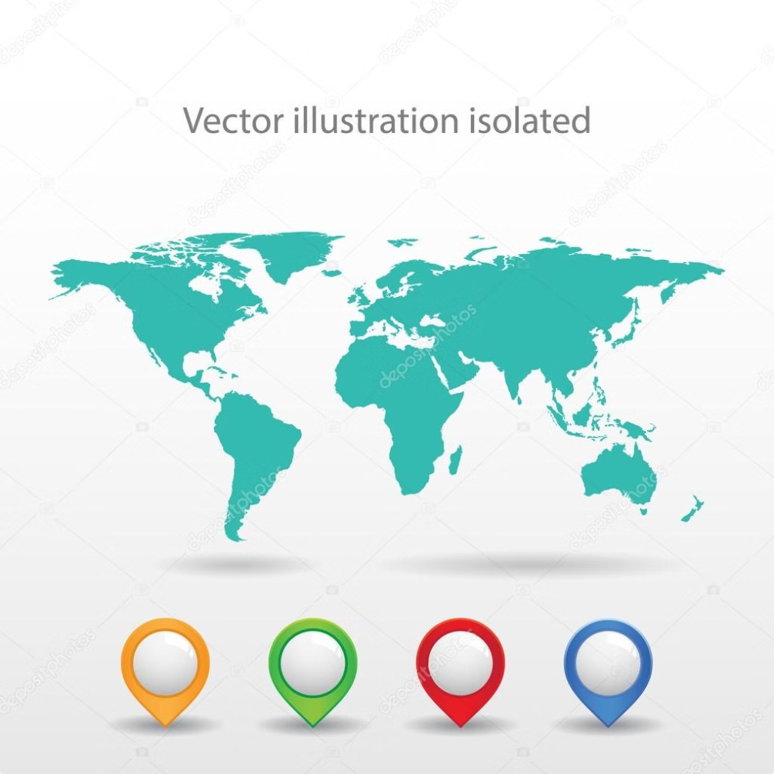
Global CO2 Emissions: A KPI Dashboard
This presentation provides an analysis of global carbon dioxide emissions, a key indicator of climate change. It explores trends, geographic distribution, and sectoral contributions to guide policy and interventions.

Slide 2


Total CO2 Emissions
Current Levels
Historical Trends
Global CO2 emissions reached a record high in 2022, exceeding 40 billion tonnes.
Emissions have steadily risen since the Industrial Revolution, accelerating in recent decades.
Projected Growth
Without significant mitigation efforts, emissions are projected to continue rising, exacerbating climate change.

Slide 3


Top Emitting Countries
China
United States
India
Russia
Japan
27% of global emissions
14% of global emissions
7% of global emissions
5% of global emissions
3% of global emissions

Slide 4

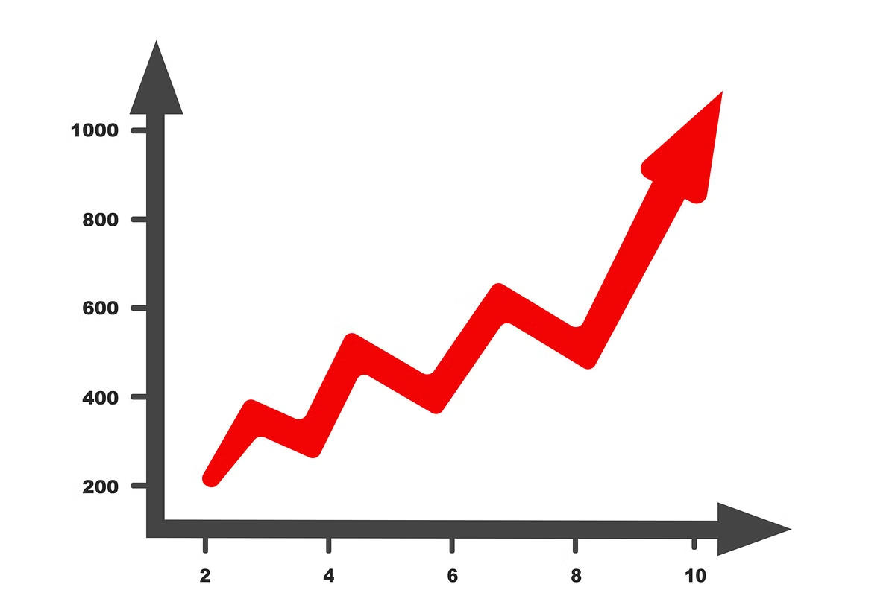
Yearly Emissions Trends
1
1990-2000
Emissions grew steadily, fueled by economic growth and increased energy consumption.
2
2000-2010
Emissions saw a significant increase due to rapid industrialization in developing nations.
3
2010-Present
Emissions growth has slowed slightly, but remains at alarming levels, demanding immediate action.

Slide 5
Geographic Distribution of Emissions
Asia
North America
Europe
The region accounts for the largest share of global emissions, driven by China and India.
The United States is the largest emitter in the region, with emissions primarily from energy production and transportation.
Emissions have declined in Europe in recent years, driven by policy measures and technological advancements.

Slide 6

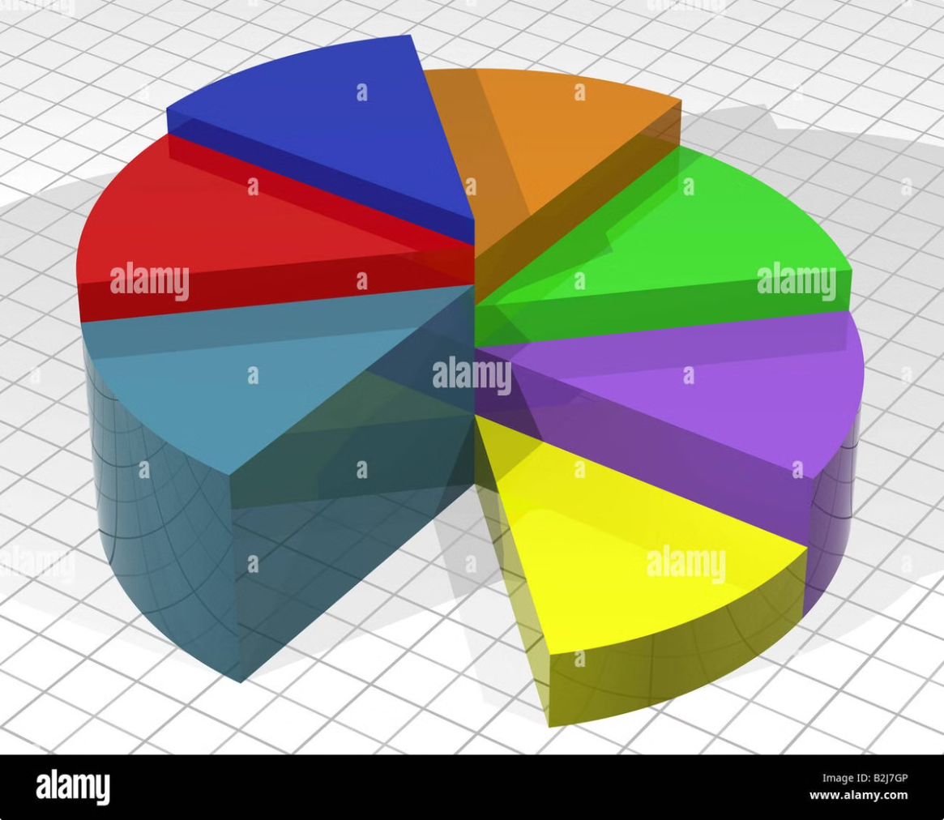
Sector-wise Contributions to Emissions
1
Energy Production
2
Industry
The largest contributor, accounting for roughly two-thirds of global emissions, largely from fossil fuel combustion.
Manufacturing, construction, and other industries generate substantial emissions, primarily from energy use and process emissions.
3
Transportation
4
Agriculture and Forestry
Emissions from vehicles, ships, and aircraft contribute significantly, largely driven by fossil fuel dependence.
Land-use changes, deforestation, and livestock farming contribute a substantial portion of emissions.

Slide 7


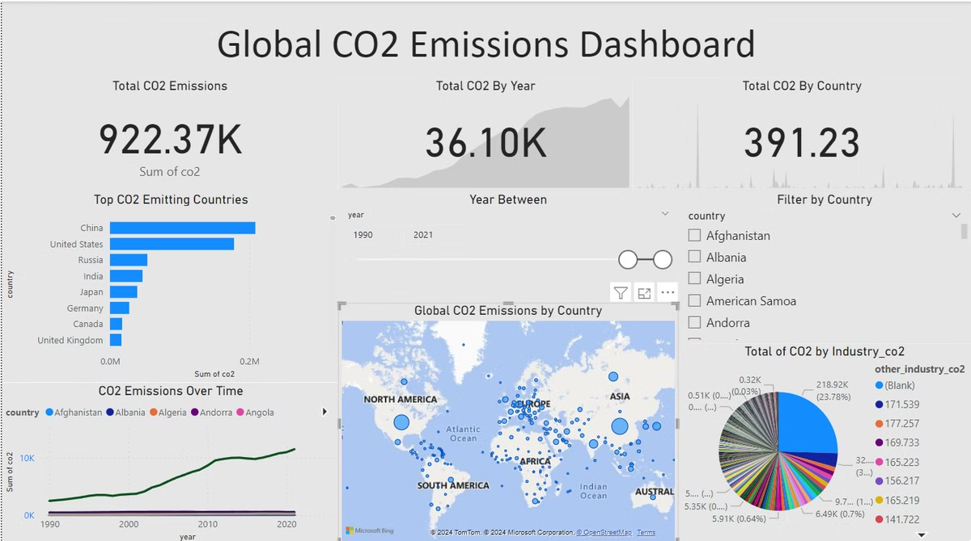


Key Insights: Emission Trends, Major Emitters, Industry Impact
Rising Emissions
Global CO2 emissions continue to rise, fueled by economic growth and energy demand.
Major Emitters
China, the United States, and India are the largest emitters, accounting for a significant share of global emissions.
Industry Impact
Energy production, industry, transportation, and agriculture are the major contributors to emissions, highlighting the need for sector-specific policies.

Slide 8






Guiding Policy and Interventions
Carbon Pricing
Renewable Energy
Energy Efficiency
International Cooperation
Implement carbon taxes or cap-and-trade systems to incentivize emissions reduction.
Promote investments in solar, wind, and other renewable energy sources to reduce dependence on fossil fuels.
Encourage energy-efficient technologies and practices across all sectors, including buildings, transportation, and industry.
Foster global collaboration and partnerships to address climate change through shared goals and technology transfer.

Slide 9


Conclusions and Next Steps
Global CO2 emissions pose a significant threat to the environment and future generations. Addressing this challenge requires urgent and coordinated action. This presentation has highlighted key trends, major emitters, and industry impacts. Continued monitoring, research, and development of innovative solutions are crucial for achieving meaningful emissions reductions.

